Slide 1
Regression Model Building 2: Model assessment
Michael Otterstatter
BCCDC Biostats Session
Aug 2, 2019

Slide 2
Session overview
In this session we will continue to discuss
Key components in the model building process
Models as a tool for exploring and describing data

Slide 3
From last session…
Building a regression model requires careful thought throughout, not simply a ‘cookbook’ activity of following predefined steps
In general, you must consider and decide
What is the purpose of my model (describe, explain, predict)?
What type of model is appropriate for my purpose and data (ordinary linear, generalized linear, etc.)?
What is the best fit model for my data?

Slide 4
Descriptive modeling
Here we focus on descriptive modeling, which aims to
summarise or represent data in a compact manner
capture associations between dependent and independent variables
generate hypotheses (but not test hypotheses)
Different from
explanatory modeling: hypothesis testing - based on underlying causal theory
predictive modeling: model as a tool for predicting new observations

Slide 5
Our data
As an example, we consider individual-level clinic data from STI sentinel surveillance (provided by Clinical Prevention Services, BCCDC)
Chlamydia and gonorrhea diagnoses (2006-17) were linked to infectious syphilis diagnoses (up to 12-months after)
Patient-level information is based on case report forms and linkage to HIV surveillance data
Our interest is to describe the associations between syphilis diagnosis and the patient characteristics

Slide 6
Our data
Variables available for modeling building:
syph_dx - Patient had a syphilis diagnosis during the study period (yes/no)
earliest_age_grp - patient age groups (15-19, 20-24, 25-29, 30-39, 40-59, 60+ years)
hiv_atoc - Patient had HIV at the time of syphilis diagnosis (yes/no)
everlgv – diagnosis with lgv anytime (lifetime or within study period)
gender_bin – Patient sex categories (M, F, NA)
surveillance_region_ha - Patient's Health Authority of residence
ctgc_cat - Number of chlamydia or gonorrhea diagnoses patient had during study period (1-2, 3-4, 5+)
post2011 - Chlamydia/gonorrhea diagnosis was after 2011 (yes/no)

Slide 7
What type of model?
The outcome of interest (syphilis dx: yes or no) is binary – what type of model would be an appropriate choice?
We use binomial (logistic) regression as an illustrative example
In the accompanying R script, we analyse the probability of syphilis diagnosis in association with patient-level covariates (demographics, previous STI diagnoses)

Slide 8
Building a model
Although there are many approaches to model building, one always needs to
visualise the data: summary statistics, plots, etc.
choose a candidate model (simple model, full model, etc.) as a starting point, assess fit, add or remove covariates
compare the fit of candidate models against one another and against the observed data
generate predicted (‘fitted’) values and/or residuals (‘errors’) values from model and assess fit
Examine goodness-of-fit statistics (AIC, BIC, dispersion)

Slide 9
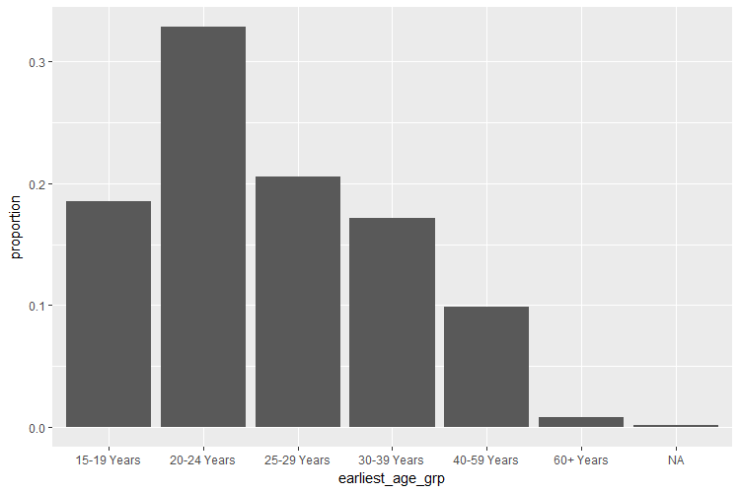
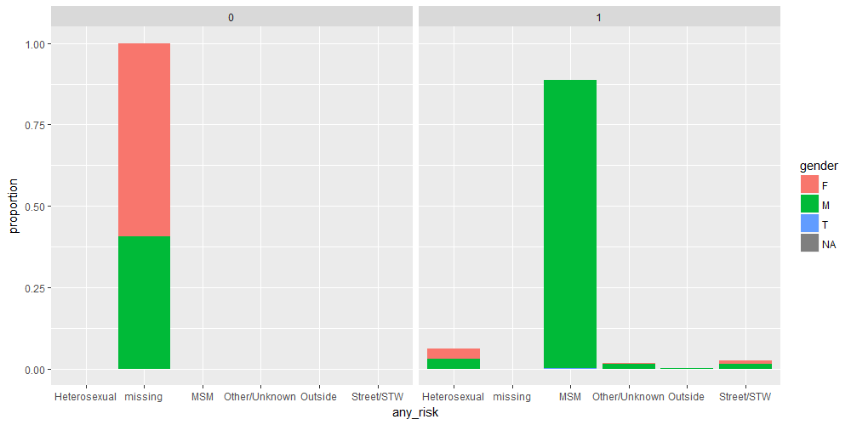
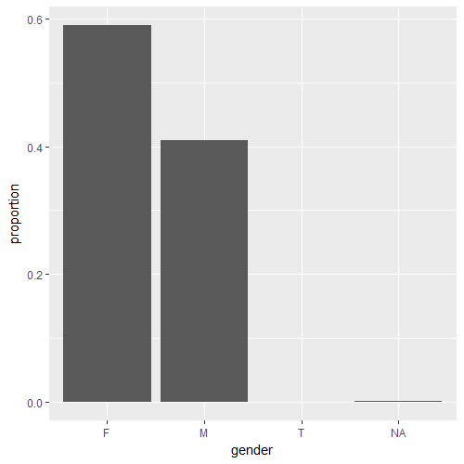
Visualise the data
We looked at that last session…

Slide 10
Choose a candidate model
As an example, consider the age-only model:
Prob(syphilis dx) = patient age
Now what??
Often models are run without much attention to whether or not they are a good fit
Always consider visualisation – what does my model fit look like? Is it a good fit to the underlying data?
age_only_model <- glm(syph_dx ~ earliest_age_yrs, family = "binomial", data = analysis_data)

Slide 11
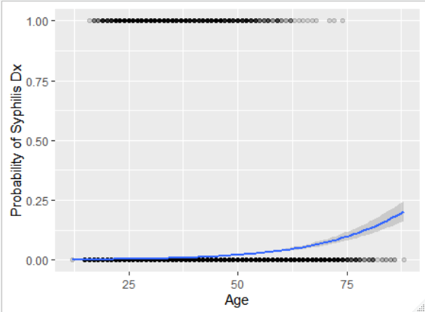
Choose a candidate model
Visualise the model fit: plot probability of syph_dx as a function of patient age

Slide 12
Choose a candidate model
Assess model fit: summarise model fit, residuals and deviance (measure of goodness of fit in generalized linear models)
summary(age_only_model) #
anova(age_only_model, test="Chisq")

Slide 13
Choose a candidate model
Assess model fit: age is a significant predictor, with increased probability of syphilis dx with increasing age
# Coefficients:
# Estimate Std. Error z value Pr(>|z|)
# (Intercept) -7.090126 0.095191 -74.48 << 0.001***
# earliest_age_yrs 0.064993 0.002465 26.37 << 0.001***
# Df Deviance Resid. Df Resid. Dev Pr(>Chi)
# NULL 132901 9938.7
# earliest_age_yrs 1 553.54 132900 9385.1 << 0.001***

Slide 14
Choose a candidate model
Assess model fit: but the distribution of residuals is quite skewed, suggesting a poor model fit
# Deviance Residuals:
# Min 1Q Median 3Q Max
# -0.6727 -0.1081 -0.0890 -0.0781 3.4793
#
# Residual deviance: 9385.1 on 132900 degrees of freedom
# AIC: 9389.1

Slide 15
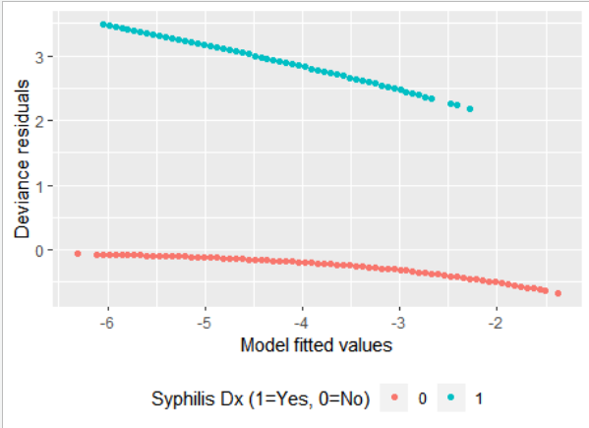
Choose a candidate model
Assess model fit: plotting the distribution of residuals can help assess model fit

Slide 16

Choose a candidate model
Assess model fit: formal goodness-of-fit statistics can also help assess model fit
For example, Nagelkerke’s pseudo R²
Proportion of deviance explained by model, similar to traditional R² in simple linear models
In this case, only 6% of deviance explained by age-only model
(1-exp( ((age_only_model$deviance)-(age_only_model$null.deviance)) / (age_only_model$df.null+1) )) /
(1-exp( -(age_only_model$null.deviance) / (age_only_model$df.null+1) ))
[1] 0.05768332

Slide 17
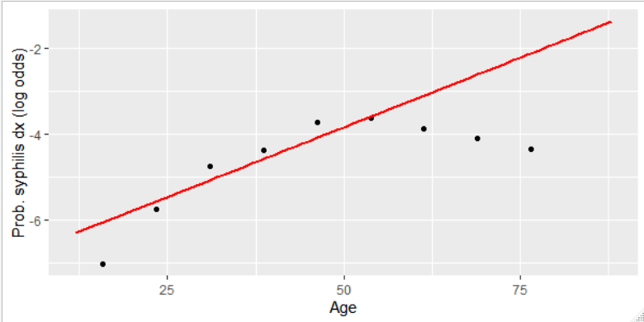
Choose a candidate model
Assess model assumptions: check linearity
Calculate observed proportions (as log odds) and compare with linear model fit – does the actual relationship look linear?

Slide 18
Choose a candidate model
Assess model assumptions: check outliers
In looking for unusual observations, it is helpful to calculate 'influence measures', which indicate impact of each data point on the overall model fit
inf.measures <- influence.measures(age_only_model)
as.data.frame(inf.measures$infmat) %>%
rowid_to_column() %>%
ggplot() + geom_point(aes(x = rowid, y = dfb.1_))

Slide 19
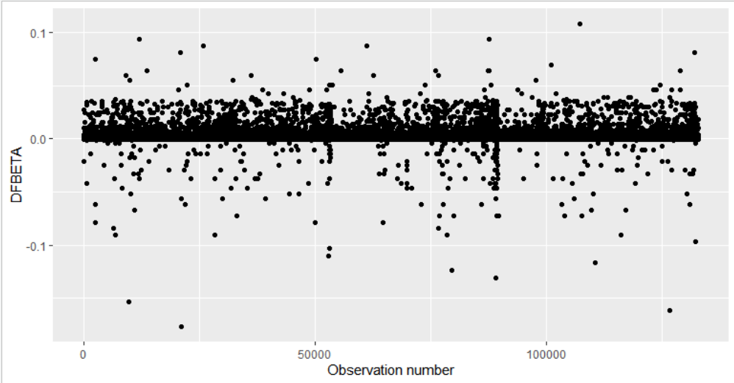
Choose a candidate model
Assess model assumptions: check outliers
In looking for unusual observations, it is helpful to calculate 'influence measures', which indicate impact of each data point on the overall model fit

Slide 20
Next time
Comparing the fit of differing models…

